Slide 1
Zoe - Take Home Task
Zsolt Nyiri
2023-08-27

Slide 2
Table of Contents
Data sources & tools used
Data inspection, quality check and added features
Creating the staging-, dimension and derived fact tables
Most popular start and end stations
Relationship between the number of docks and the number of bicycles hired
Station expansion based on high usage
Commuting Patterns
Rental duration analysis
Most common times of day and days of week for bicycle hire (+ monthly trends)
London weather data analysis

Slide 3
Data sources & tools used
Data sources
London Bicycles Dataset
Contains 2 tables:
bigquery-public-data.london_bicycles.cycle_stations
A station lookup table with 795 unique stations installed between 2010-06-19 and 2022-10-17
bigquery-public-data.london_bicycles.cycle_hire
A ride level table with data between 2015-01-04 and 2023-01-15
Additional 3rd party data sources utilized:
London weather data
London Geo map
Tools and tech used:
BigQuery (SQL)
Google Collab (Python)

Slide 4
2. Data inspection, quality checks and added features
Numerous corrections and improvements were implemented to enhance the quality of the datasets. Here are a few examples:
The ride durations had negative values
Upon thorough inspection, I found that these negative values occurred exclusively on the last Sunday of October (across multiple years) for rides that commenced between 1 and 2 am and concluded after 2 am
This coincided with the clock shift and were properly adjusted
Many stations had a missing station_id between August 31, 2016, and September 6, 2016. This information was instead stored in a different field within this timeframe. I backfilled into the original column.
Numerous stations experienced changes in their names or station_ids. To address this, I consolidated these changes to establish a consistent and unique name and id that aligned with the stations dataset.
Additionally, a variety of new features were developed to facilitate future analyses. Here are a few examples:
Is the bike electric?
Did the ride occur during a weekend?
In which season did the ride take place?
And so forth.

Slide 5
3. Creating the staging, dimension and derived fact (marts) tables
All the fixes and improvements (along with those previously mentioned) were stored in two staging tables:
stg_cycle_stations
stg_cycle_hire
These staging tables were then used to create a combined source of truth table:
dim_cycle_data
A lookup table for later use (storing all the station properties with the cleaned up ids and names) was also created:
dim_cycle_stations
Lastly, a derived fact tables was created that stored all the previous data, but was rolled up to an hourly level for the analysis, and another one combining the London weather data with the hire dataset.
drv_fact_cycle_data
drv_fact_cycle_hire_weather_combined

Slide 6
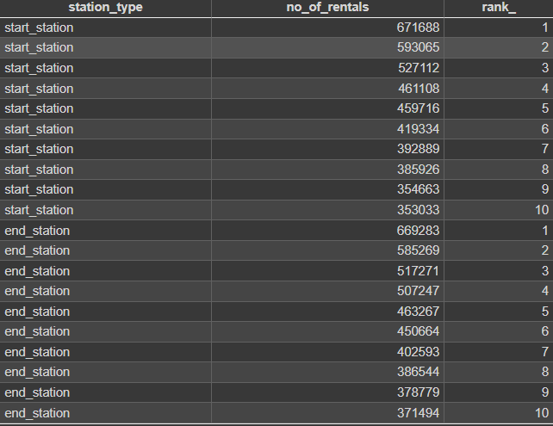
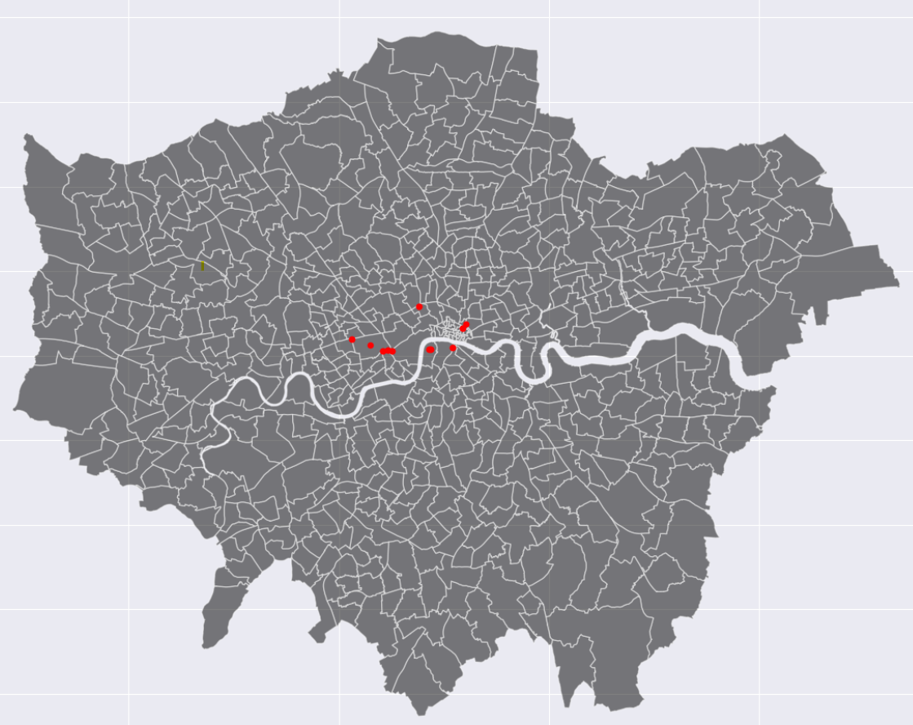
4. What are the most popular start and end stations?
Out of the 10 most popular starting stations, 9 are also featured among the most frequently used ending stations
The top 10 starting stations account for 5.5% of the total traffic. Notably, these stations are concentrated downtown, encompassing areas such as London City and Westminster. This concentration suggests that the daily commute to work exerted the most significant influence on these patterns.

Slide 7
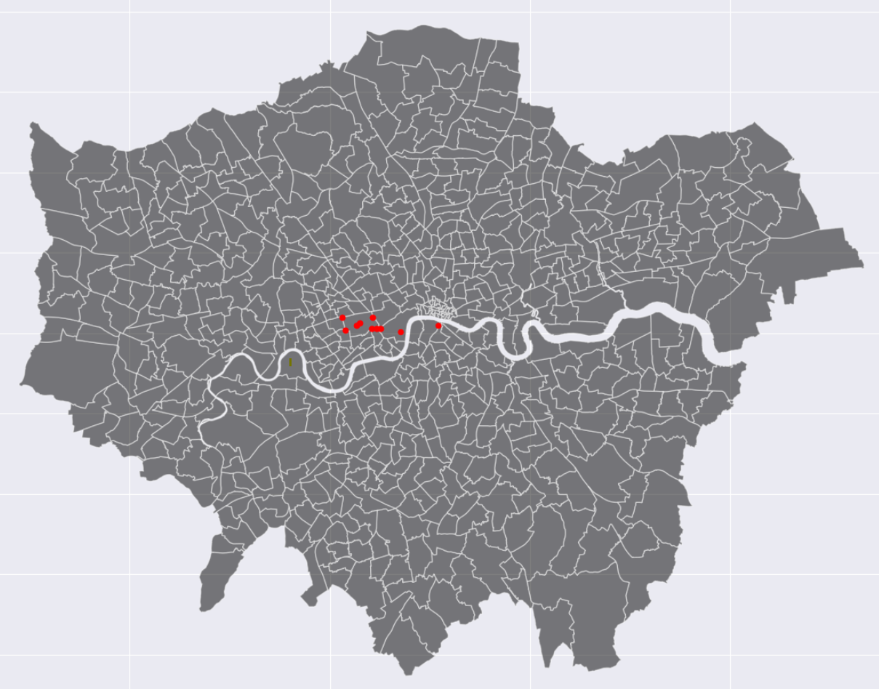
4. What are the most popular start and end stations?
Nevertheless, when we narrow our focus to weekend rides, a distinct pattern emerges. The majority of the most popular stations are clustered around Hyde Park, indicating a strong inclination towards recreational purposes.

Slide 8
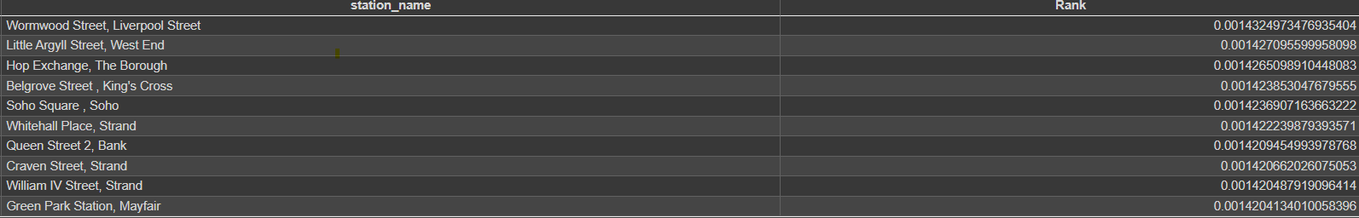
4. What are the most popular start and end stations?
An alternative approach to gauging popularity is by computing station PageRank, a network ranking technique famously used by Google for search result rankings.
PageRank takes into account a variety of factors beyond mere traffic volume (or in this context, the number of journeys)
For instance, it considers the number of connections each station possesses and evaluates the significance of these connections within the broader network graph
The outcomes diverge somewhat from rankings based solely on frequency, although there is a degree of overlap. Exploring these variations could serve as a compelling next step, offering insights into the disparities and the implications they might hold

Slide 9
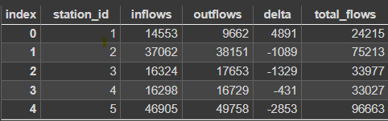
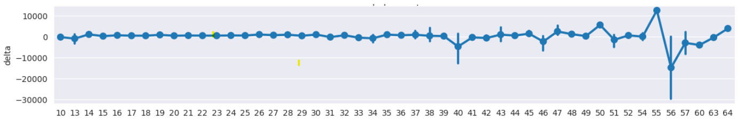
5. Is there a relationship between the number of docks and the number of bicycles hired?
An alternative approach to assessing station utilization involves analyzing inflow and outflow numbers, as well as their difference (referred to as delta, i.e., inflow - outflow)
For example:
When examining the correlation between station deltas and the number of docks, the relationship is not entirely definitive; however, a noticeable trend emerges. Stations with larger delta differences tend to be associated with higher numbers of docks, although the correlation is not absolute.

Slide 10
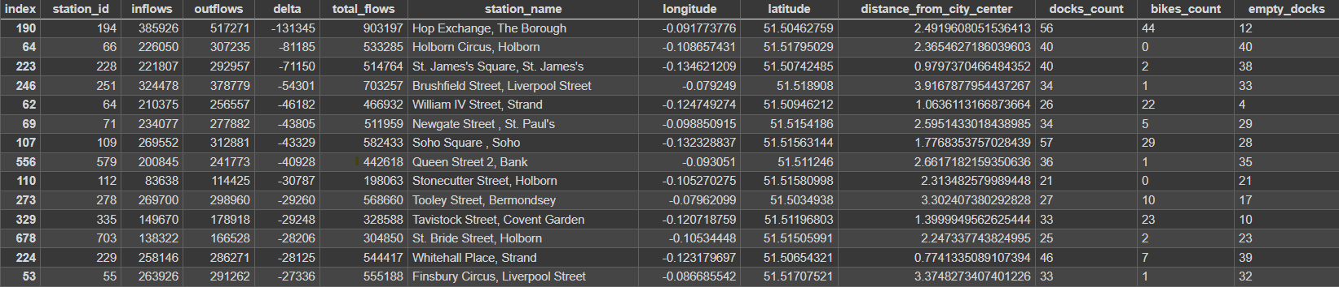
6. Are there any stations that should be expanded based on high usage?
A station's need for docks increases proportionally with the aforementioned delta value.
A significantly negative delta indicates that more bikes are leaving the station than arriving. These stations require restocking to prevent running out of bikes too rapidly and causing user frustration. Here are a few examples to illustrate:
Certain stations on this list, such as William IV Street in Strand, have a mere 26 docks, despite their high popularity (evidenced by high total flows) and substantial negative delta.
In the case of Holborn Circus, although the number of docks is relatively substantial (though it could be improved), the presence of 0 bikes_count raises concerns. This situation suggests that all available bikes might have been taken, which is especially troubling given that this station primarily serves as an outflow point.

Slide 11
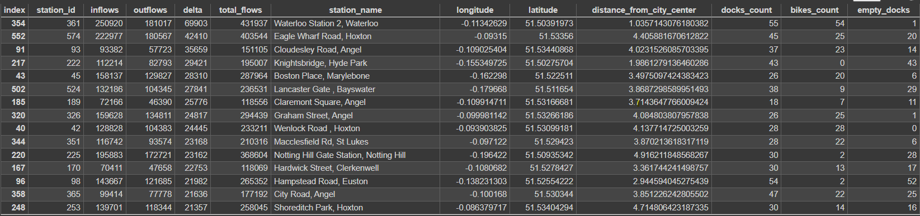
6. Are there any stations that should be expanded based on high usage?
Examining the situation from the opposite perspective (high positive delta), there's evident room for improvement, characterized by a need for a substantial docks count and a low count of available bikes:
Waterloo Station, despite boasting a considerable number of docks, currently only offers 1 empty dock. This scarcity implies that individuals might struggle to find available spaces to park their bikes, which is concerning given that it ranks as the station with the highest positive delta.
A similar pattern can be observed with other stations, such as Graham Street and Wenlock Road. These stations not only share the aforementioned scenario of low bike availability and high positive delta but are further disadvantaged by their limited dock counts.

Slide 12
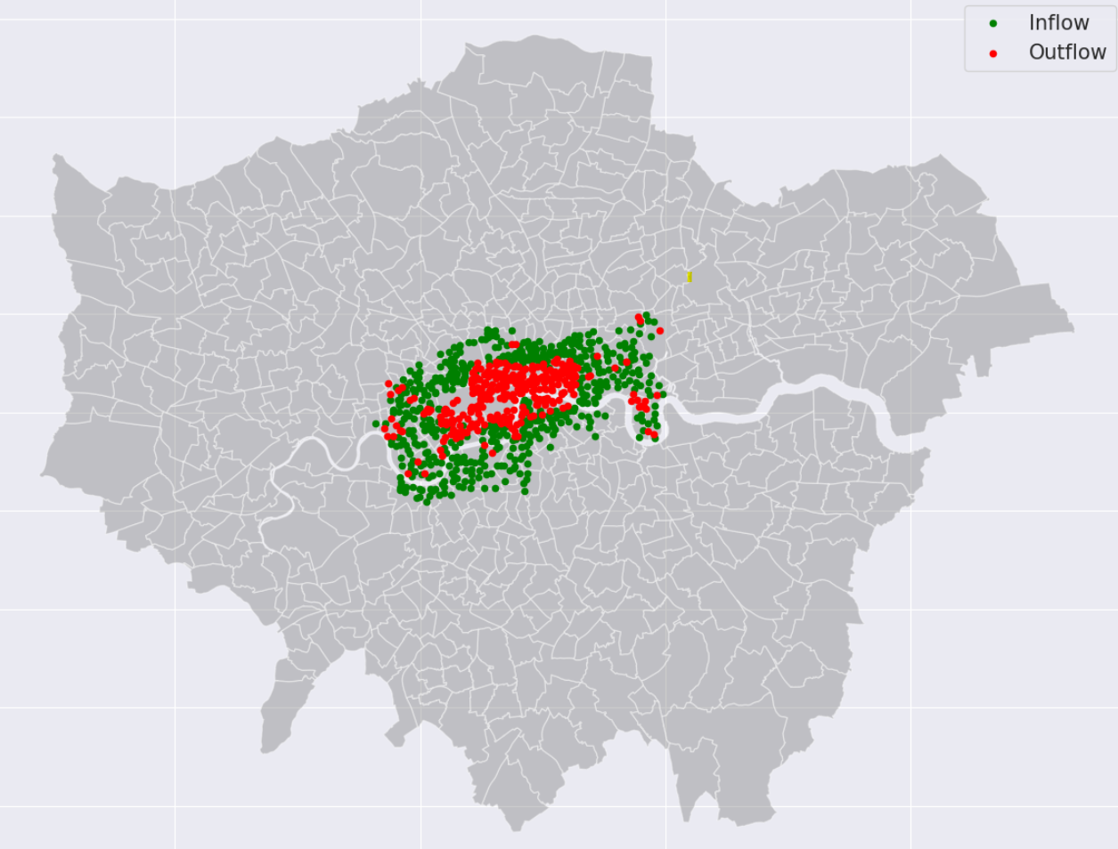
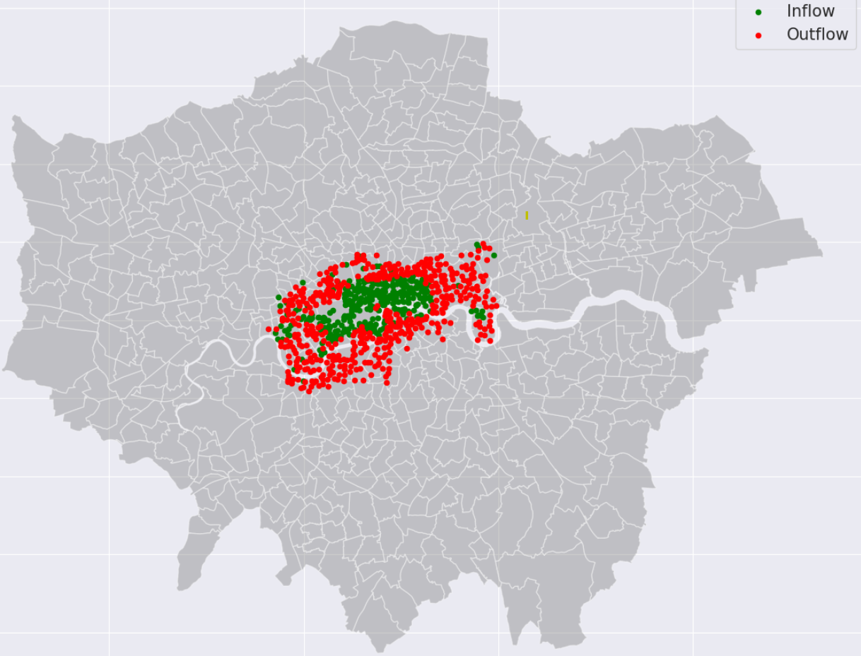
7. Commuting Patterns
By segmenting the dataset into two timeframes rides occurring between 7 and 10 in the morning and rides between 17 and 20 in the evening on weekdays an insightful approach emerges. Each station can be categorized using flags derived from the calculated delta values (negative indicating outflow and positive indicating inflow).
This analysis effectively exposes the commuting patterns of Londoners. Leveraging this perspective could provide an avenue to refine bike counts at various stations, specifically tailored to the corresponding time periods, thus enhancing overall system optimization.
Mornings
Evenings

Slide 13
8. Rental duration analysis
During the inspection of the base cycle_hire_source table it became apparent that there are some anomalies there which worth looking into.
There are 27546 rides that exceed the legal maximum of 24 hours in duration, the highest being 94025 minutes (!)
Even though this is only 0.03% of all the rides, there is indication that people are doing it so there might be a potential market for long term bike renting
This would be worth investigating either as a separate product, or just somehow incorporate into the current business model
The negative durations anomaly was already covered earlier
There are also 19518 cases where the end station id is completely missing, hence these rides don’t have durations nor end times
This indicates that either there are bugs in the tracking system - if so this should be investigated
Or these bikes were never returned (stolen?) - if so this should be tracked and the security measures should be revised in order to minimise these numbers

Slide 14
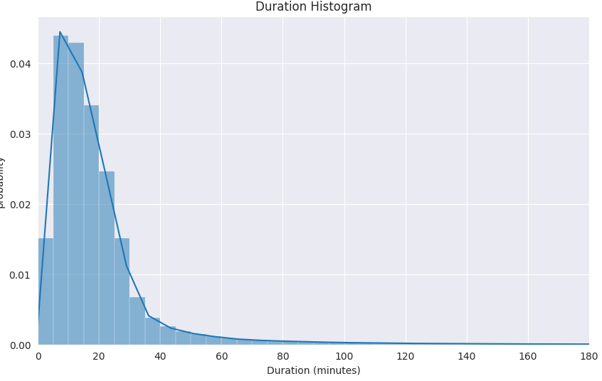
8. Rental duration analysis
Average ride duration is approximately 1308 seconds, while the mode is only 840 seconds.
This suggests a significantly skewed distribution, likely due to the presence of considerable outliers.
Examining the distribution of durations allows us to attain a clearer understanding of the actual ride patterns.
As anticipated, the distribution exhibits a pronounced leftward tilt.
Short rides (lasting less than 5 minutes) are equally frequent as rides lasting 25-30 minutes.
The majority of rides fall within the 0-40 minute range, with longer rides exceeding 90 minutes being highly improbable.

Slide 15
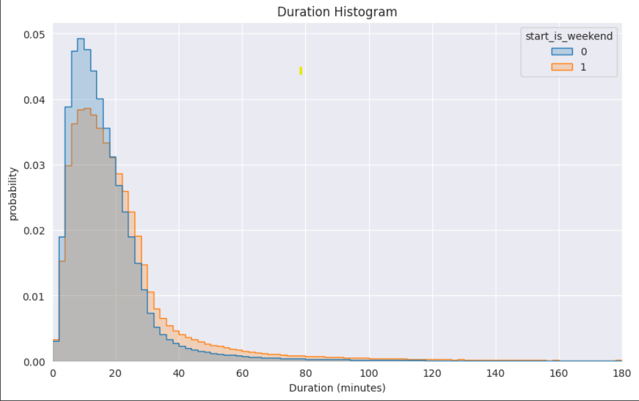
8. Rental duration analysis
Analyzing the same distribution, but divided by weekday and weekend usage, reveals notable insights. Despite the reduced number of rides on weekends, these tend to be somewhat longer. The distribution exhibits a gentler decline and a higher tail, indicating extended ride durations.
For instance, the likelihood of 40-minute leisure rides is nearly double on weekends compared to weekdays. This observation underscores how user behavior shifts during weekends, with a preference for more extended rides, possibly driven by recreational activities.

Slide 16
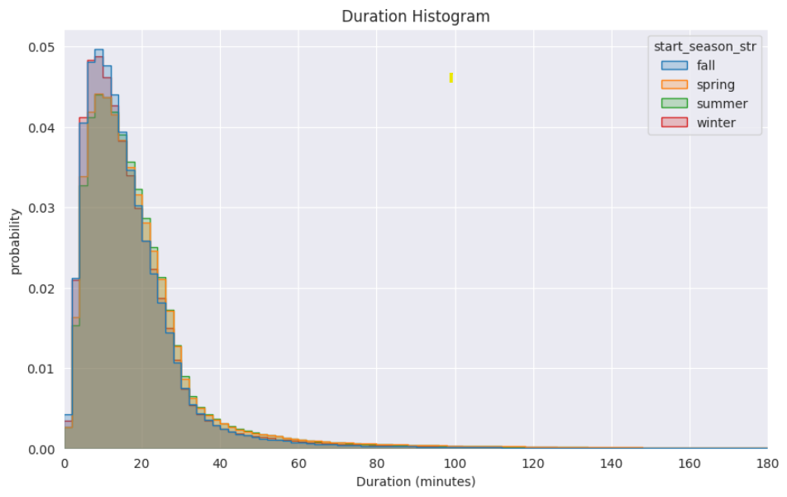
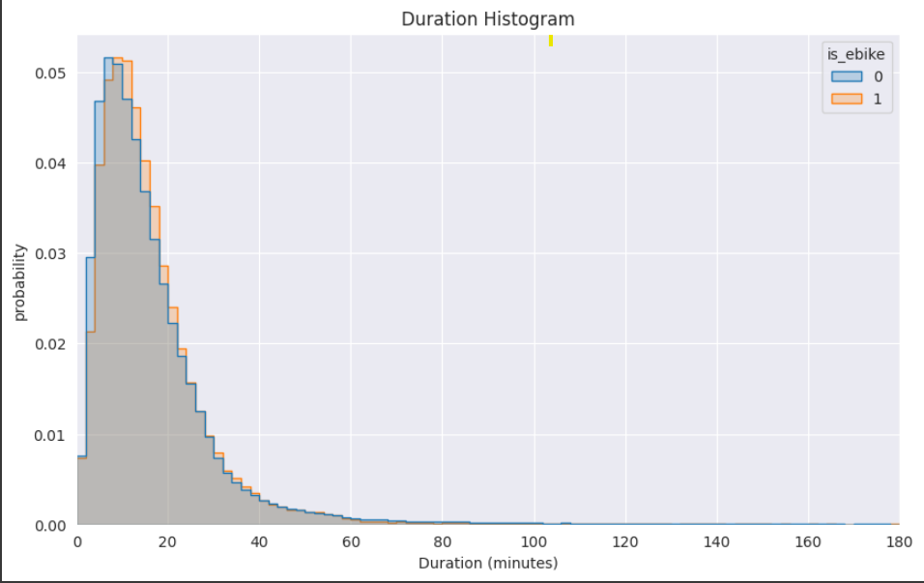
8. Rental duration analysis
The seasonal effect mirrors that of the electric bike usage: people tend to ride for 2-4 minutes longer in the spring and during the summer. This suggests a consistent trend of extended ride durations during these seasons, potentially influenced by more favorable weather conditions and increased outdoor activities.
Electric bikes exhibit a comparatively smaller impact on the distribution tail; the overall shape of the distribution remains largely unchanged. However, there is a discernible shift of approximately 4 minutes towards longer ride durations. This suggests that while electric bikes influence ride lengths, the fundamental distribution pattern remains consistent, albeit slightly skewed towards extended durations.

Slide 17
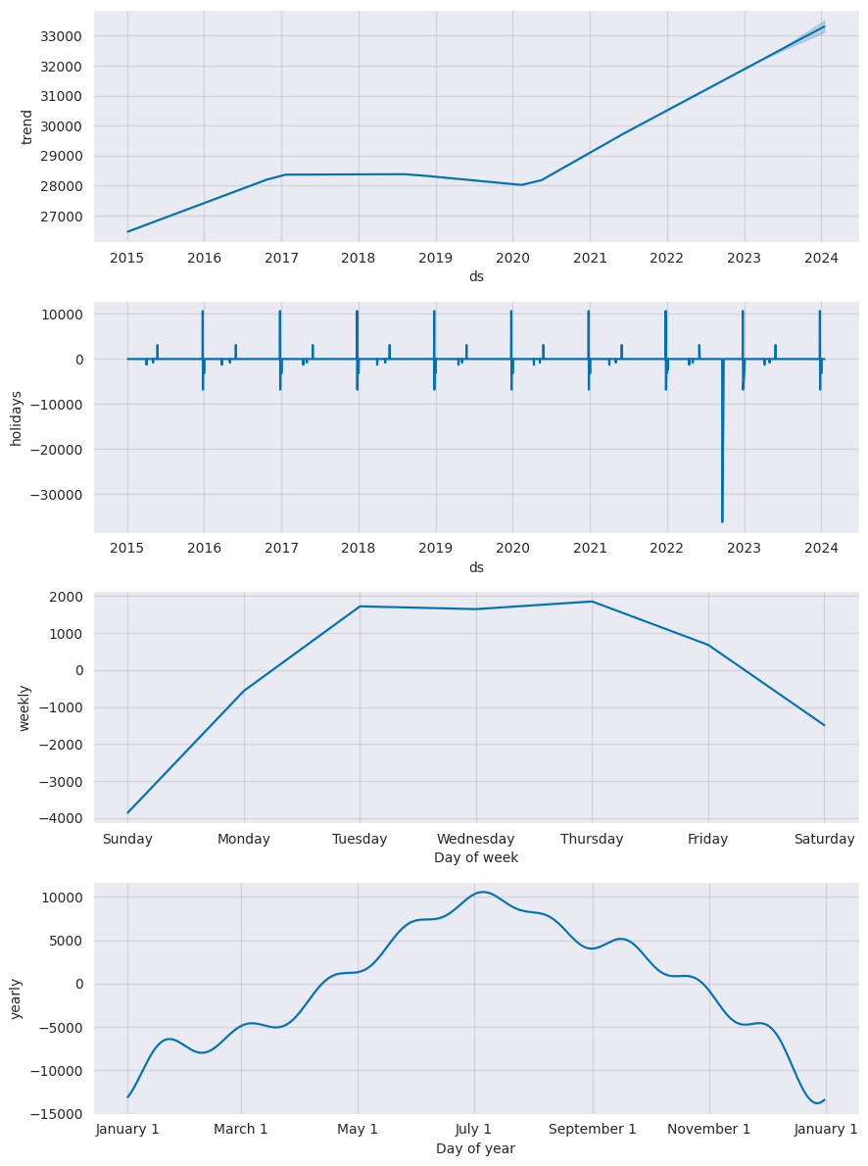
9-10. Most common times of day and days of week for bicycle hire (+ monthly trends)
Utilizing Facebook's Prophet algorithm, I crafted two distinct models: one operating on a daily level and another on an hourly level. Analyzing the Daily model offers several key insights:
A discernible trend was observed from 2015 to 2017, exhibiting growth that then plateaued, and even slightly decreased until the onset of Covid. However, post-Covid, a remarkable surge was noted, showcasing substantial upward momentum.
Projections indicate the continuation of this upward trend throughout 2023-2024.
Bank and national holidays wield varied impacts on usage, with some occasions witnessing an increase and others yielding a decrease.
A noticeable outlier in late 2022, attributed to the Queen's funeral, witnessed a significant reduction in usage due to the bank holiday.
Bike utilization tends to be lowest during the weekend, gradually increasing until Tuesday when it peaks. Thereafter, a gradual decline is observed until Thursday.
Monthly seasonality is evident, with January recording the lowest usage. Subsequent months experience an ascent, albeit with some fluctuations, until reaching a peak around July. Subsequently, a decline ensues.
These observations can inform strategies for system optimization and resource allocation, helping anticipate future trends and variations in bike usage patterns.

Slide 18
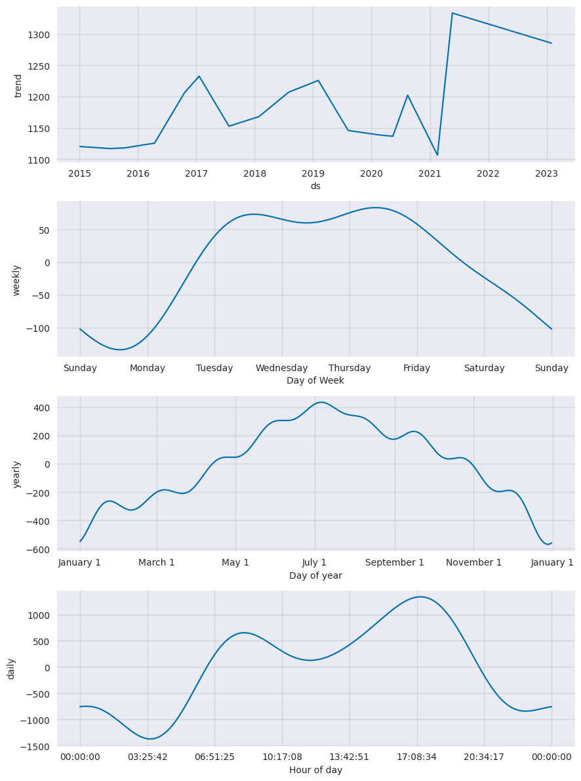
9-10. Most common times of day and days of week for bicycle hire (+ monthly trends)
Examining the hourly model reveals consistent trends, albeit with greater detail due to the granularity of the data. Additionally, this model incorporates daily seasonality, offering further insights:
Usage commences a gradual increase at around 4 am, reaching a peak between 9 to 9:30 am, which corresponds with the morning commute.
Subsequently, there is a slight dip during the day.
Another rise occurs in the late afternoon, with a notable peak around 5 pm, aligning with the after-work commute.
A gradual decrease ensues until the early hours of the following day, with a minor uptick around midnight, which could potentially be attributed to the "pub commute."
These findings reinforce the commuting patterns observed in the daily model, adding an hourly perspective and highlighting distinct peaks in bike usage during morning and evening commuting hours. This nuanced understanding can inform strategies for optimizing bike availability and operations during specific times of the day.

Slide 19
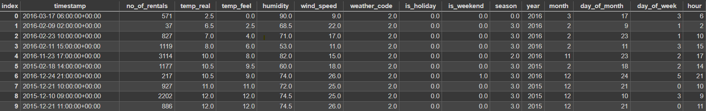
11. London weather data analysis
To conduct the weather analysis, I utilized the drv_fact_cycle_hire_weather_combined table, which combines third-party hourly weather data with the provided usage data. This integration also includes supplementary date-related features that I generated. This approach allows for an exploration of how weather conditions impact bike usage patterns, providing a comprehensive understanding of the interplay between weather and bike rentals.

Slide 20
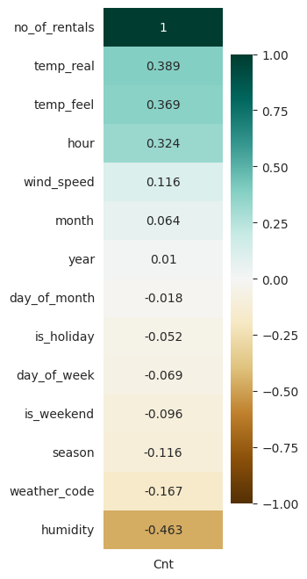
11. London weather data analysis
Following an assessment for multicollinearity, which indicated the absence of any multicollinearity issues, intriguing correlations have emerged. Notably:
The number of rentals displays a positive correlation with temperature and the hour of the day.
Conversely, there is a negative correlation between the number of rentals and humidity.
These correlations underscore the influence of weather factors, particularly temperature and humidity, on bike rental patterns. The positive correlation with temperature suggests increased usage during warmer conditions, while the negative correlation with humidity implies a decrease in rentals during more humid weather. Additionally, the positive correlation with the hour of the day aligns with the commuting patterns observed in the previous analyses.

Slide 21
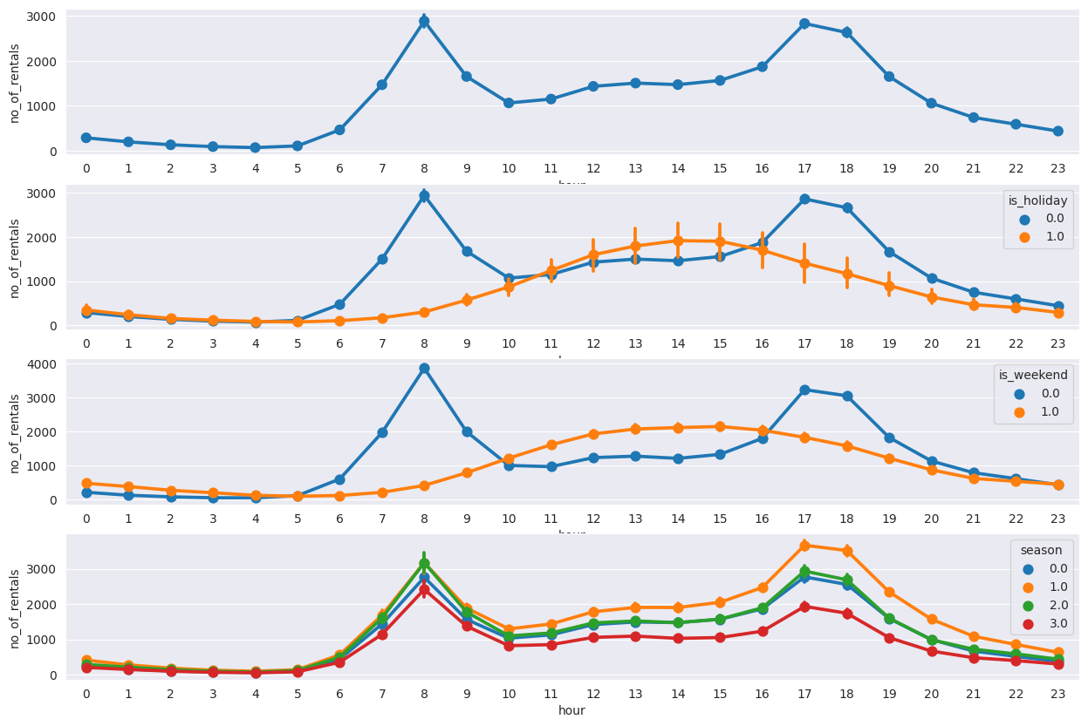
11. London weather data analysis
Analyzing rentals in relation to the hours of the day reveals several trends:
Consistent with previous findings, the number of rentals follows a bimodal distribution throughout the day, with peaks around 8 am and 5-6 pm, reflecting morning and evening commuting patterns.
When isolating data for holidays, this trend transforms into a single modal distribution with a flatter shape.
Weekends exhibit a similar pattern to holidays, further reinforcing the flattening effect on the distribution.
Considering seasons, Summer registers the highest overall usage, particularly in the late afternoon. Spring and Fall fall in between, while Winter significantly lags behind in terms of bike usage.
These trends provide valuable insights into how usage patterns fluctuate throughout the day, across holidays, weekends, and seasons, aiding in optimizing bike availability and operational strategies.

Slide 22
12. Conclusions
User Patterns and Trends
Ride usage follows bimodal peaks around 8 am and 5-6 pm.
Holidays and weekends reshape the pattern to a flatter distribution.
Ride count positively correlates with temperature and hour of the day.
Negative correlation observed with humidity.
Seasonal Insights
Usage peaks during Summer, tapers in Spring and Fall, and dips in Winter.
Spring and Summer rides extend by 2-4 mins compared to other seasons.
Electric bikes have a modest impact, shifting distribution by ~4 mins.
Ride Durations and Weather
Ride durations exhibit a skewed distribution with heavy leftward tilt.
Short rides (<5 mins) as common as 25-30 min rides.
Majority of rides fall within 0-40 min range.
Weekend and Weekday Behavior
Weekends see fewer rides, but longer durations.
Distribution declines gently with a higher tail on weekends.
40-min leisure rides almost double on weekends.
Strategic Implications
Expand stations with highest deltas for optimized docks.
Organize access bike transfers considering delta variations.
Optimize bike availability during peak commuting hours.
Optimize resources for commuting peaks (8 am, 5-6 pm).
Cater to varied seasonal patterns for efficient operations.
Prioritize bike availability during favorable weather conditions.
Account for extended weekend ride preferences

